Slide 1

#4 Sentiment Analysis Assignment
Prajakta A. Ninave
200543035
GitHub: https://github.com/prajaktaninave20/Sentimental-Analysis-for-Tweets
Kaggle Link: https://www.kaggle.com/datasets/gargmanas/sentimental-analysis-for-tweets?select=sentiment_tweets3.csv

Slide 2





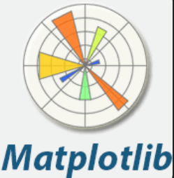

Project Architecture
Data Acquisition
Data Preprocessing
Data Export
Regex
Pandas
csv
Pandas
Sentiment Analysis
Data Visualization
TextBlob

Slide 3
Project Architecture
Data Acquisition: Involves reading and loading the dataset into a DataFrame.
Data Preprocessing: Cleans the text data by removing unwanted characters, URLs, and formatting the text for analysis.
Sentiment Analysis: Uses the TextBlob library to compute the sentiment polarity and categorizes it into Positive, Negative, or Neutral.
Data Visualization: Uses visual tools like Matplotlib and Seaborn to plot the sentiment analysis results, and WordCloud to represent the most frequent words.
Data Export: Saves the processed and analyzed data back into a CSV file for documentation or further use.
TextBlob

Slide 4
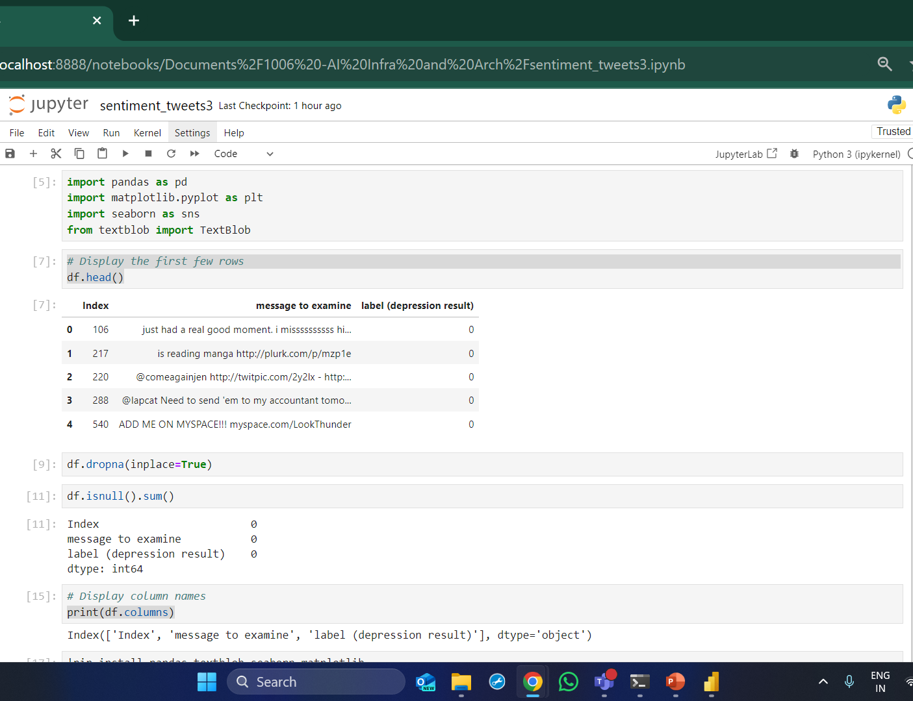
Code / lib used
Pandas
Matplotlib
Textblob
Nltk
Seaborn
Wordcloud

Slide 5
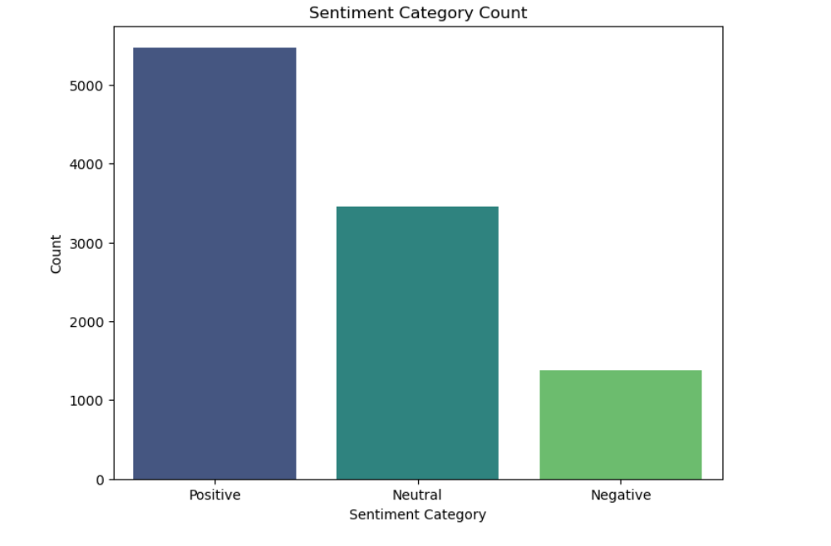
Project screenshots

Slide 6
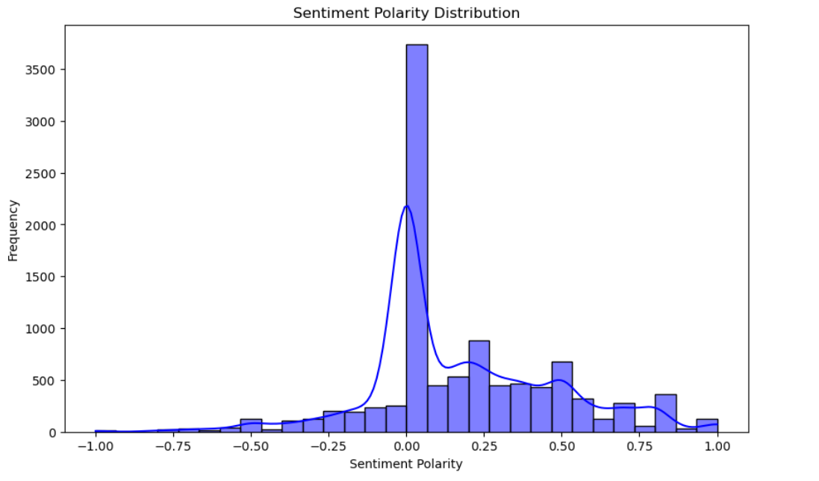
Project screenshots

Slide 7
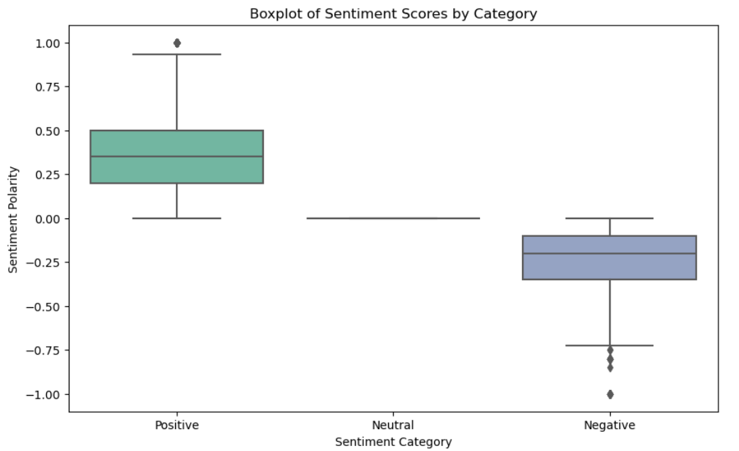
Project screenshots

Slide 8
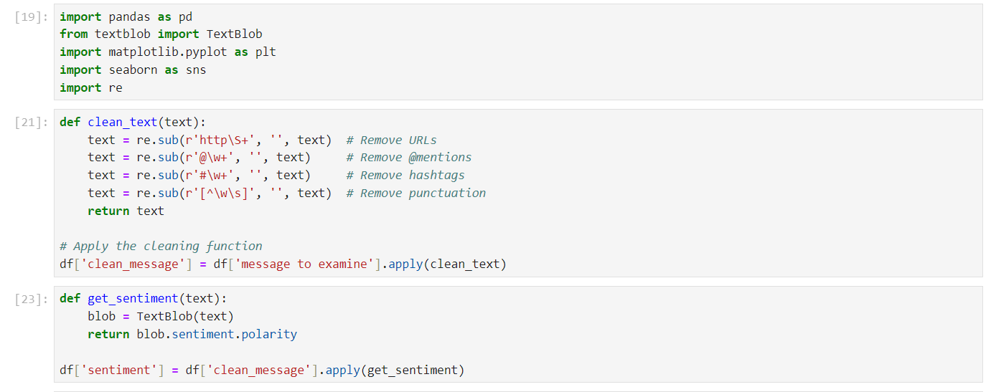
Project screenshots

Slide 9
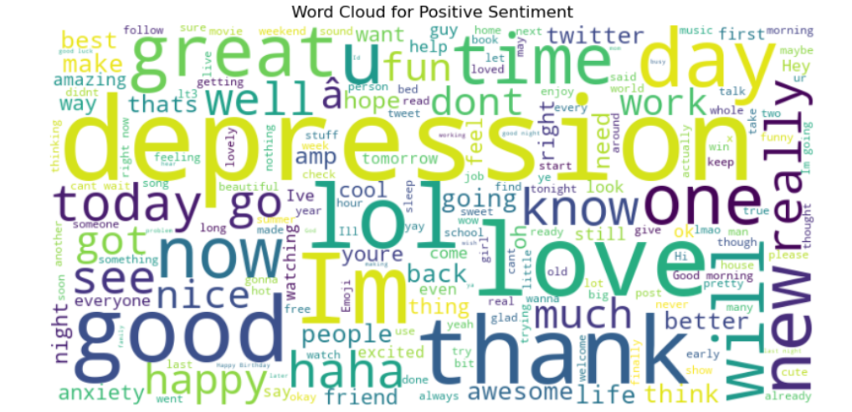
Project screenshots

Slide 10
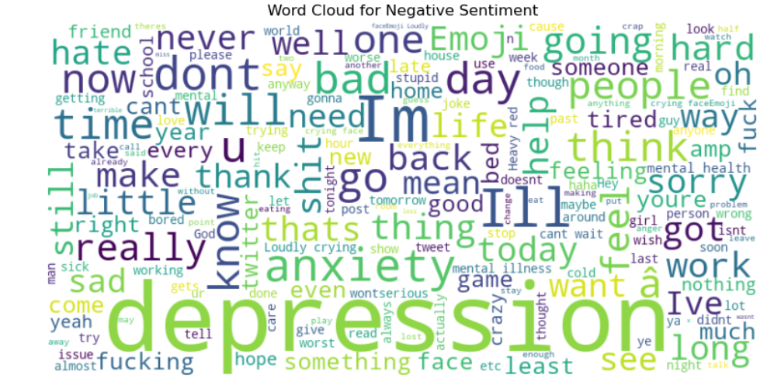
Project screenshots

Slide 11
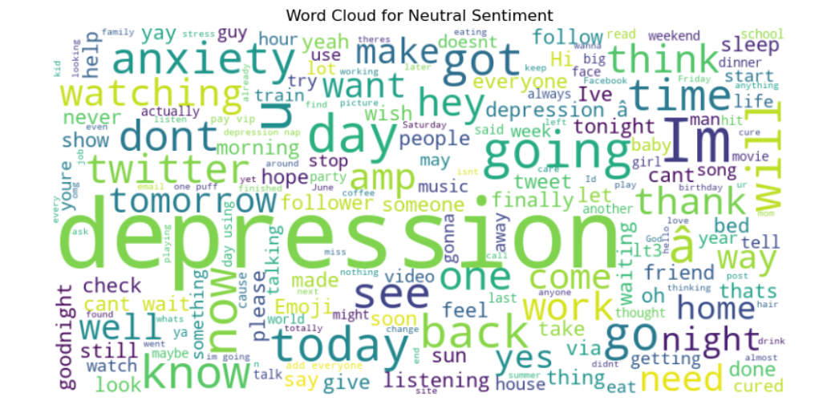
Project screenshots

Slide 12
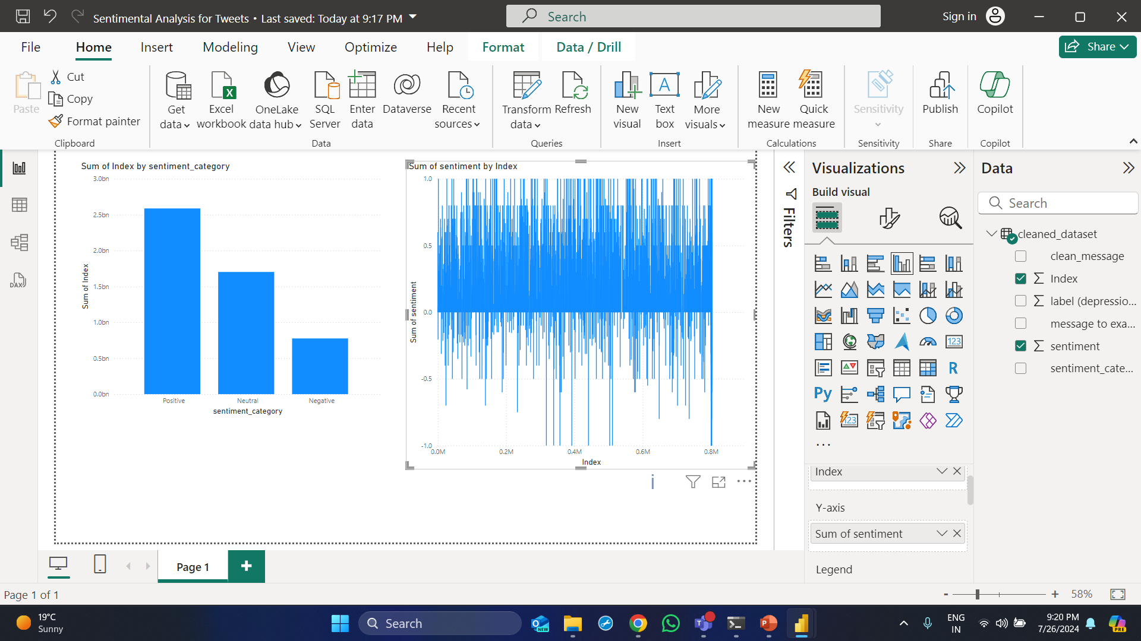
Project screenshots

Slide 13
Project screenshots
Data Ingestion: The description includes loading the dataset using Pandas, which is a standard approach for handling data in Python. However, details about the data format (CSV, Excel, etc.) and potential issues (e.g., missing data) could be expanded upon.
Data Preprocessing: The preprocessing steps are well-detailed with regex operations to clean the text data. Additional preprocessing techniques such as stemming, lemmatization, or handling stopwords could be mentioned for a more comprehensive approach.
Sentiment Analysis: The use of TextBlob for sentiment analysis is explained with clear code snippets. The explanation could be enhanced by discussing alternative sentiment analysis tools (e.g., VADER, spaCy) and the rationale for choosing TextBlob.
Data Storage:Detail: The explanation covers saving the processed data using Pandas. It could be improved by discussing different storage options (e.g., databases) depending on the project scale.
Data Visualization: Provides multiple visualization options with code examples. Could include more advanced visualizations or interactive plots using libraries like Plotly for more dynamic analysis.
Reporting and Documentation: Uses Jupyter Notebook for documentation, which is appropriate for interactive reports. Suggesting additional tools (e.g., Jupyter Book, Sphinx) for more extensive documentation might be useful.

Slide 14
Thankyou

